Slide 1


Gujarat University School of Emerging Science and Technology CC-416 Project-III : Project
Topic : Machine Learning Approach for Student Dropout Prediction: A Comparison of Logistic Regression and
Linear Discriminant Analysis
DS-09 Prem Patel
Enroll no:- 202222600013

Slide 2

Machine Learning Approach for Student Dropout Prediction: A Comparison of Logistic Regression and Linear Discriminant Analysis

Slide 3
Abstract
Student dropout is a significant issue in higher education. This study uses the UCI Student Dropout Dataset to predict whether a student will Dropout, Graduate, or Remain Enrolled.
Two models, Multinomial Logistic Regression and Linear Discriminant Analysis (LDA), are applied and compared.
The results show that Logistic Regression provides slightly better predictive performance, while LDA is faster and computationally efficient.
The study highlights how statistical models can support early identification of at-risk students and improve retention strategies.

Slide 4
Objective
To develop and evaluate a machine learning-based approach for predicting student academic outcomes (Dropout, Enrolled, Graduate) using educational data, and to compare the performance of Multinomial Logistic Regression and Linear Discriminant Analysis in terms of accuracy, efficiency, and interpretability, while identifying key factors influencing student dropout.

Slide 5
Logistic Regression (Multinomial Logit)
Linear Discriminant Analysis
Supervised classification algorithm for multiclass prediction
Estimates probability of each class using softmax function
Assigns class with highest probability
Provides interpretable coefficients (feature importance)
Uses regularization to reduce overfitting
Performs well on structured/tabular data
Classification and dimensionality reduction technique
Maximizes class separation and minimizes variance
Assumes normal distribution of data
Projects data into lower-dimensional space
Works efficiently for multiclass problems

Slide 6
Why Logistic Regression & LDA?
Logistic Regression provides high accuracy and probability-based predictions
LDA offers fast computation and stable performance
Both models allow easy comparison of performance metrics
Help identify important features influencing student dropout
These models were selected because they provide an optimal balance between accuracy, interpretability, and computational efficiency, making them ideal for educational data analysis and multiclass prediction.

Slide 7
Literature review
Ujkani, B., et al. (2022) developed a student dropout prediction model using Logistic Regression on university data. Their study achieved around 90% accuracy and F1-score of 0.85, showing that Logistic Regression is effective for identifying at-risk students using demographic and academic features. The results highlighted the importance of early prediction systems in higher education.

Slide 8
Hasan, R., et al. (2021) applied machine learning techniques including Logistic Regression, Decision Trees, and Random Forest for student dropout prediction. Their results showed that Logistic Regression provides stable performance with good interpretability, while ensemble methods slightly improve accuracy. The study emphasized the importance of academic and behavioral features in predicting dropout.

Slide 9
Maldonado, S., et al. (2020) proposed predictive models for student retention using Linear Discriminant Analysis (LDA) and other classification techniques. Their findings showed that LDA performs efficiently in multiclass classification problems when data follows normal distribution assumptions. The study also highlighted that LDA provides faster computation compared to other machine learning models.

Slide 10
Challenges
Data quality & imbalance
Model assumptions (LDA)
Limited real-world features
Overfitting & interpretability trade-off
Privacy & deployment issues

Slide 11
Dataset + Preprocessing
UCI Student Dropout Dataset
Real-world student academic and demographic data
Multiclass target variable: Dropout , Graduate , Enrolled
Suitable for educational analytics and prediction tasks.
Preprocessing Steps:
Missing values handled using median imputation
Feature scaling using StandardScaler
Stratified 80/20 train-test split
Class distribution checked for balance

Slide 12
Methodology
Student Dropout
dataset sourced from
UCI Repository
Multinomial Logistic
Regression (MLR) and Linear Discriminant Analysis (LDA)
Accuracy, Precision,
Recall, F1-Score, Log-Loss, and Multi-class ROC-AUC
Dataset
Collection
Modeling
Evaluation
Preprocessing
Optimization
Visualization
Missing value handling,
stratified train–test split
(80–20), feature
standardization
Hyperparameter tuning
using Grid Search with
5-fold cross-validation
ROC curves, confusion
matrices, feature
importance, decision
boundaries

Slide 13

Model Performance Comparison
Metric | Multinomial Logistic Regression | Linear Discriminant Analysis (LDA)
Test Accuracy | 0.77 | 0.76
Mean CV Accuracy (5-Fold) | 0.7652 ± 0.0174 | 0.7584 ± 0.0132
Log Loss (↓ better) | 0.5846 | 0.6409
ROC–AUC (OvR) | 0.8779 | 0.8696
Training Time (seconds) | 0.055 s | 0.013 s
Weighted Avg F1-Score | 0.75 | 0.75

Slide 14
Class-wise Performance (F1-Score)
Class | Logistic Regression | LDA | Better Model
Dropout | 0.78 | 0.77 | Logit
Enrolled | 0.41 | 0.44 | LDA
Graduate | 0.86 | 0.85 | Logit

Slide 15
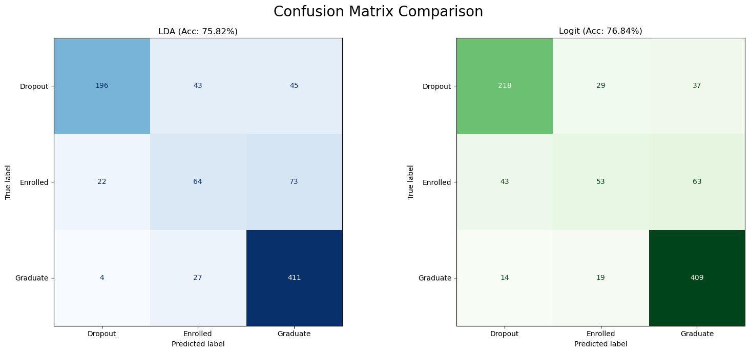

Slide 16
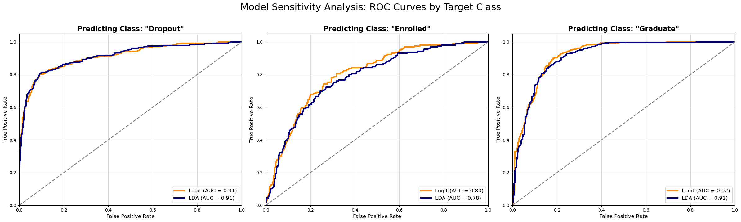

Slide 17
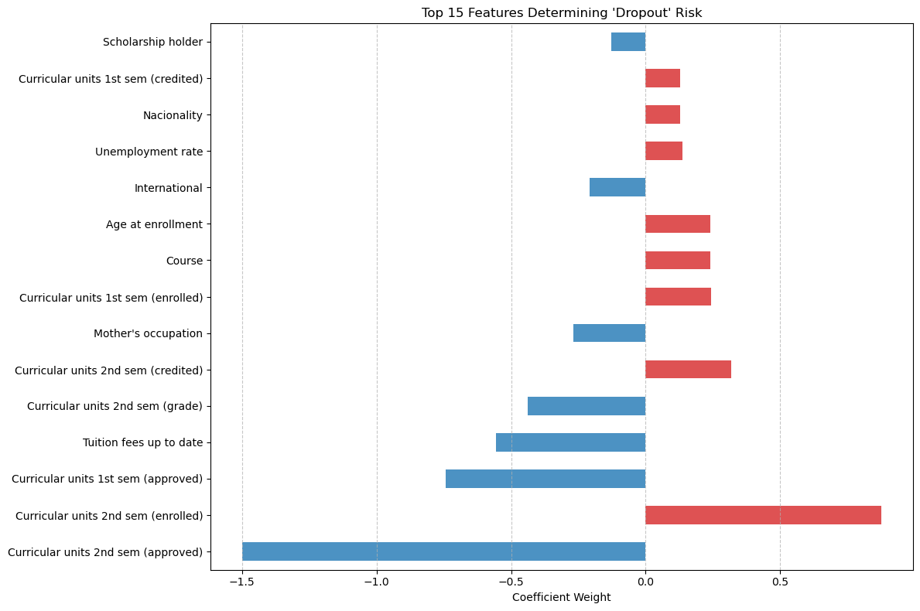

Slide 18
Key Findings
Logistic Regression achieved higher ROC-AUC and lower Log Loss
LDA showed faster computation and better stability
Logistic Regression is better for critical dropout prediction
LDA is suitable for fast and stable applications

Slide 19
Conclusion
Both models effectively predict student dropout. Logistic Regression demonstrates slightly higher accuracy and better predictive performance, while LDA is faster and more computationally efficient.
The results indicate that academic performance, particularly second-semester progress, is the most significant factor influencing dropout, followed by financial and demographic factors.
Overall, Logistic Regression is more suitable for accurate prediction, whereas LDA is preferable for faster and scalable applications.

Slide 20
Future Scope
Advanced ML models (RF, XGBoost)
Real-time prediction systems
Integration with university systems
Use of behavioral & multi-source data
Deep Learning & AI-Based Systems

Slide 21
References
Ujkani, B., Minkovska, D., & Stoyanova, L. (2022). Application of Logistic Regression Technique for Predicting Student Dropout. IEEE Conference.
Hasan, R., et al. (2021). Student Dropout Prediction using Machine Learning Techniques. IEEE Access.
Maldonado, S., et al. (2020). Predicting student retention using classification models. Expert Systems with Applications.

